Slide 1
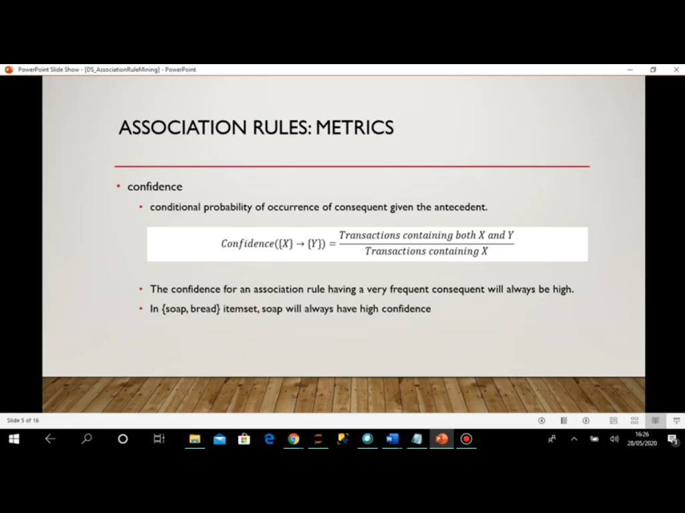

Slide 4
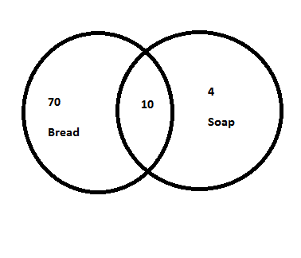
{Bread}->80 {Soap}->14 {Soap, bread}->10

Slide 5
Bread has high value so the confidence will be high.
It does not mean that soap is influencing the bread.
Does not depend much on the first item.
This is problem with confidence.
.

Slide 6
Bread}->80 {Soap}->14 {Soap, bread}->10
X Y
Confidence=10/14= 0.7
Lift=0.7(confidence)/0.8< 1
Bread was my popular itemset it does not mean that soap is increasing its sale.
Lift is helping us to determine if we combine two items together so will be increase the sale or not.

Slide 7
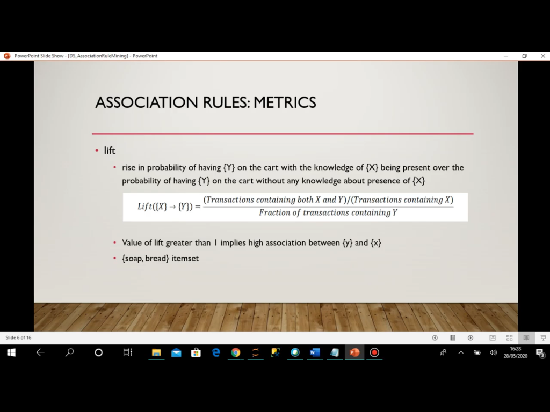

Slide 8
Now in this case the confidence value is high(numerator) and if the denominator(Transactions containing Y) is also high it means that result value will be less than one.

Slide 9
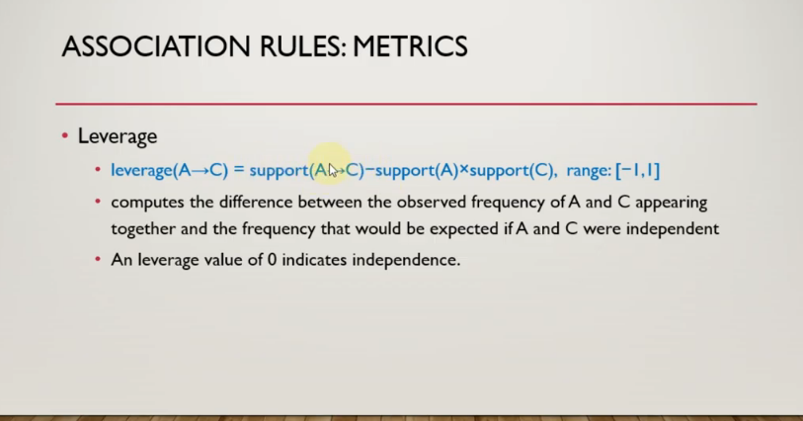

Slide 10
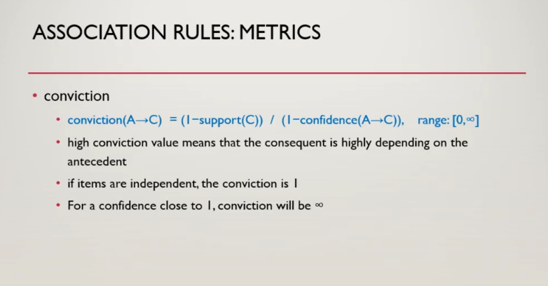
If the leverage is 0 means that if the items kept together does not increase the sale and as it reaches towards 1 means that if they combine can increase the sale.
-1 means that if they are kept together they make bad combination and can affect the sale as well.

